Slide 1
ENVE 644
12 Feb 2020
Marine Protection, Research and Sanctuaries Act (MPRSA) Section 103
Caitlin Smoot

Slide 2
Marine Protection Research and Sanctuaries Act
Passed by Congress in 1972
Basic aims:
Regulate intentional disposal of materials into ocean
Establish marine sanctuaries
Authorize related research
Etc…. (coastal monitoring)
Title I of MPRSA deals with permit and enforcement provisions for ocean dumping
MPRSA

Slide 3
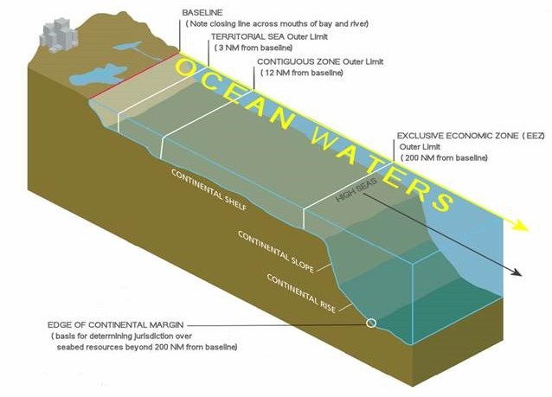
The Ocean Dumping Act
The Ocean Dumping Act
The Ocean Dumping Act
Ocean waters are
the open seas lying
seaward of the
“baseline” from
which the
“territorial seas”
are measured.
Figure credit: “An Ocean Blueprint for the 21st Century, Final Report of the U.S. Commission on Ocean Policy” from EPA.gov
MPRSA

Slide 4
The Ocean Dumping Act
MPRSA Title I
Prohibits or regulates disposition or dumping of any material in the ocean that would adversely affect human health, welfare, amenities, the marine environment, ecological systems or economic potentialities
Certain materials are prohibited:
High-level radioactive waste, chemical and biological warfare agents, medical waste, sewage sludge, and industrial waste
Other materials require a permit
MPRSA

Slide 5
The Ocean Dumping Act
The Ocean Dumping Act
The Ocean Dumping Act
Enforcement
EPA may assess civil penalties of up to $50,000 for each violation
Requires notices and opportunity for hearing
Criminal penalties are also authorized
Includes seizure of forfeiture of vessel
Coast Guard is tasked with surveillance
MPRSA

Slide 6
The Ocean Dumping Act
The Ocean Dumping Act
The Ocean Dumping Act
Who issues permits for ocean dumping?
Environmental Protection Agency (EPA) is responsible for permits EXCEPT for those involving dredged material
United States Army Corps of Engineers (USACE) is permitting authority for dredged materials (MPRSA Section 103)
MPRSA

Slide 7
The Ocean Dumping Act
The Ocean Dumping Act
The Ocean Dumping Act
Typically takes 6-18 months to obtain permit to dump dredged materials
Applicants are encouraged to consult with regional USACE district office prior to application
Could material have
beneficial use?
MPRSA

Slide 8
The Ocean Dumping Act
The Ocean Dumping Act
The Ocean Dumping Act
What information is needed for a permit?
Type of material
Sediment size and type, toxicity, chemical & biological impacts (Green Book)
Amount of material
Placement timing and method
Dumping site (Ocean Disposal Site?)
Background and state of knowledge
Inspection provisions, monitoring and reporting
Applicants are highly encouraged to consult with their regional USACE office
MPRSA

Slide 9
The Ocean Dumping Act
Dredged Material Management Program (DMMP)
USACE, Seattle District (Alaska District does not have regional management program)
Four tiers of evaluation:
Tier 1: Site Evaluation & History
Tier 2: Chemical Testing
Tier 3: Biological Testing
Tier 4: Special Studies
https://usace.contentdm.oclc.org/utils/getfile/collection/p16021coll11/id/3788

Slide 10
The Ocean Dumping Act
The Ocean Dumping Act
The Ocean Dumping Act
How are permits evaluated?
Need for dumping
Environmental impact of dumping
Impact on aesthetic, recreational or economic values
Impacts on other uses of the ocean (fishing, scientific study, navigation)
Land-based alternatives to dumping in the ocean
MPRSA

Slide 11
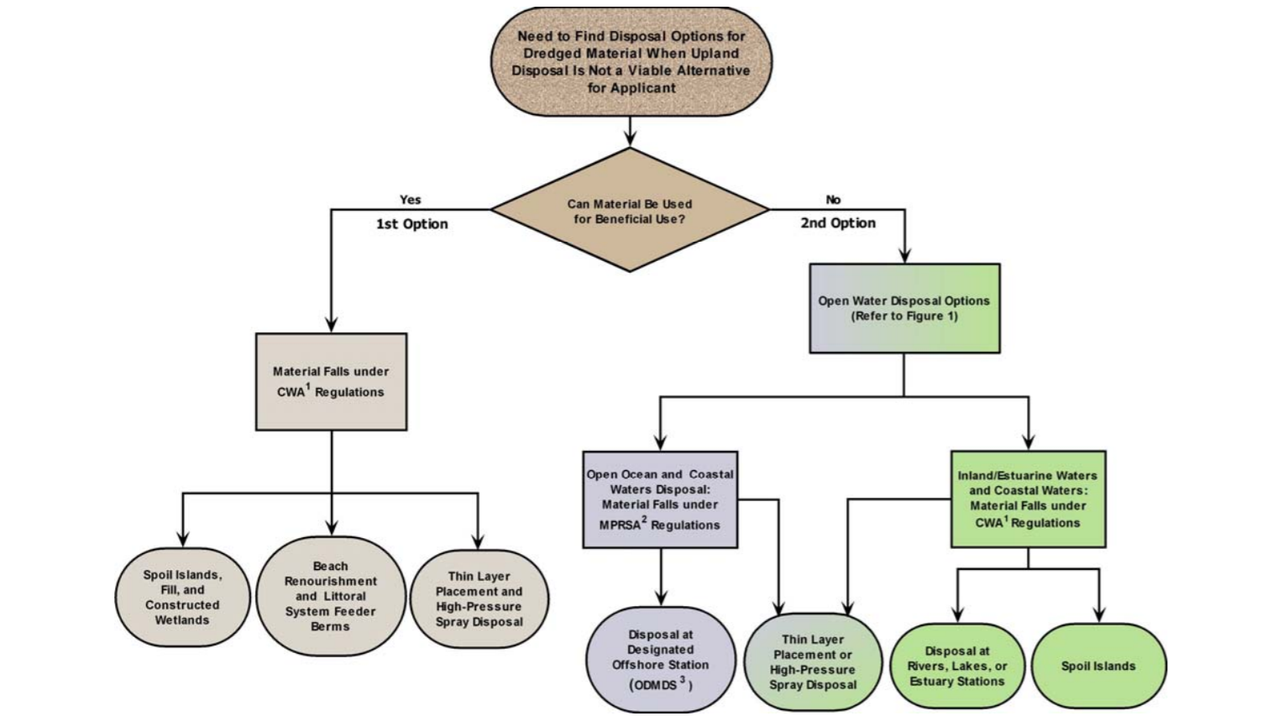
UPDATES IN ENVIRONMENTAL PERMITTING REQUIREMENTS FOR DISPOSAL OF DREDGED MATERIAL Lombardero et al

Slide 12
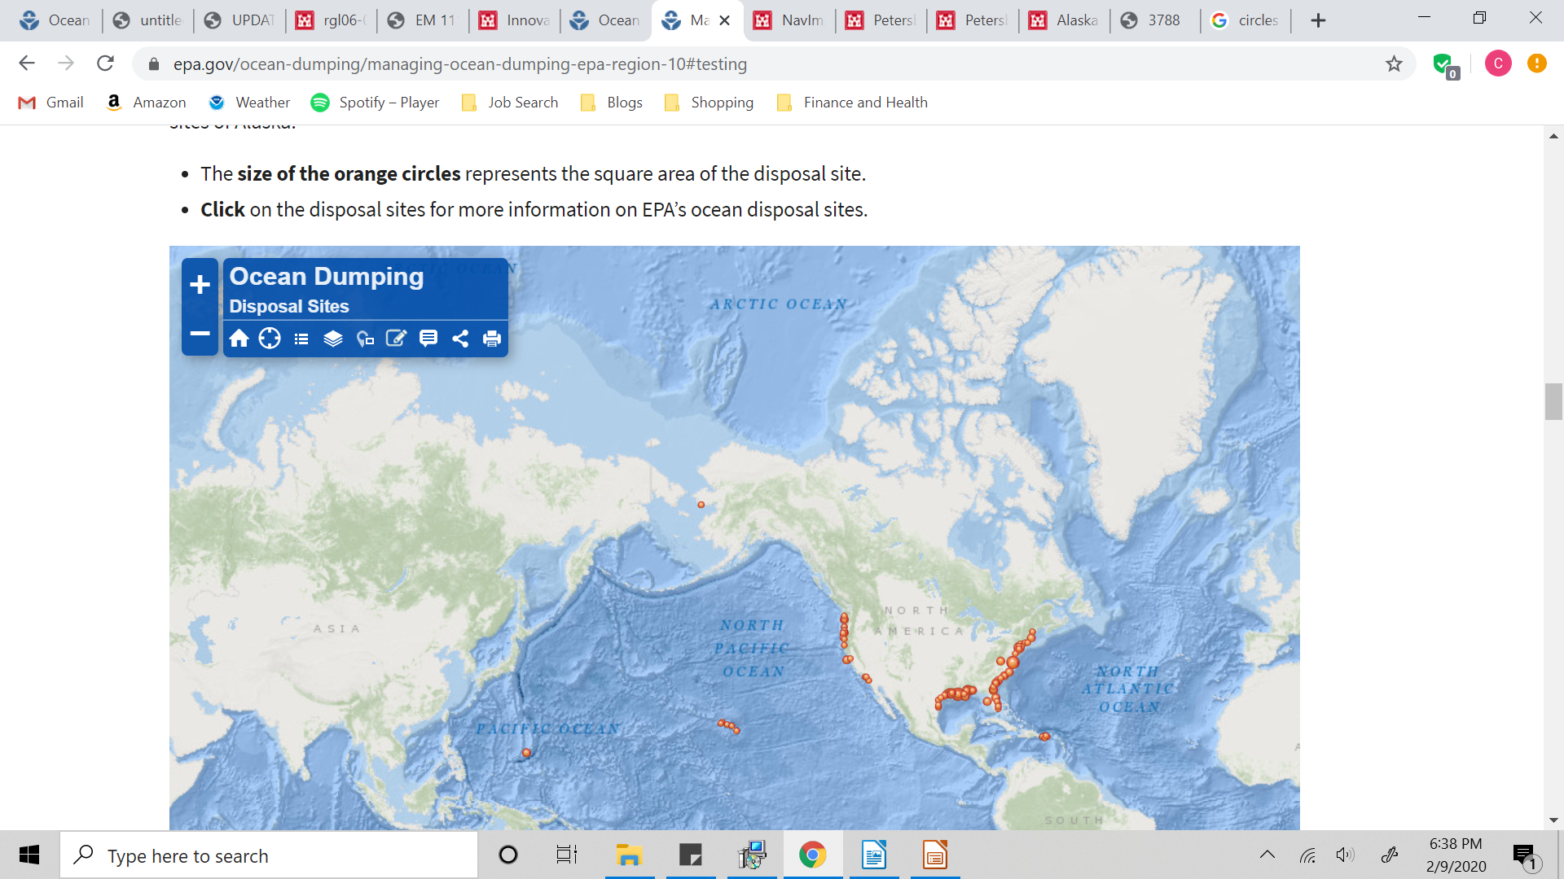
Ocean Dumping Sites
https://www.epa.gov/ocean-dumping/managing-ocean-dumping-epa-region-10#testing

Slide 13
Case Study: Petersburg, AK
USACE Alaska District proposes to deepen harbor to allow safe navigation
“ The sediment will be placed in the Frederick Sound Disposal Area in accordance with the site selection study and Ocean Dumping Permit issued by the US EPA under Section 103 of the Marine Protection, Research and Sanctuaries Act (MPRSA)”

Slide 14
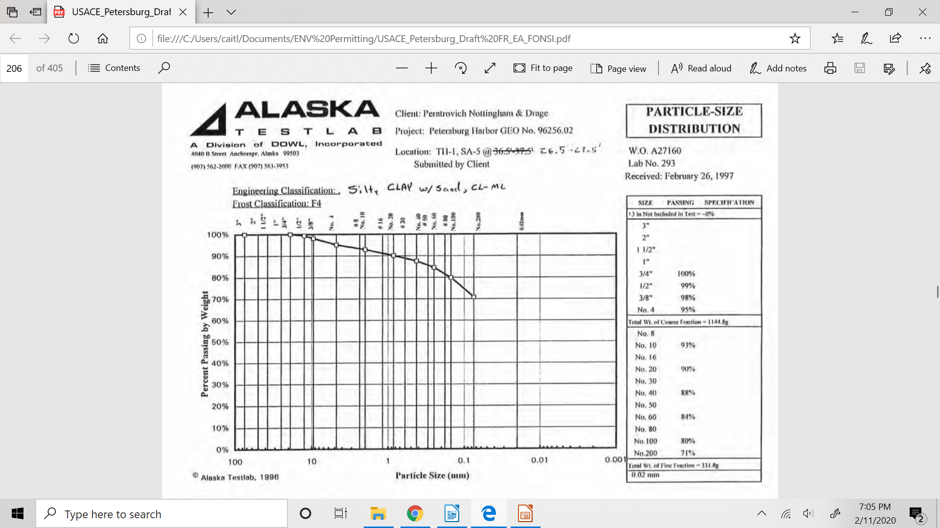
Case Study: Petersburg, AK

Slide 15
Case Study: Petersburg, AK
Mitigation measures

Slide 16
Case Study: Petersburg, AK
https://www.poa.usace.army.mil/Media/News-Stories/Article/1830813/innovative-underwater-camera-system-provides-unique-view-of-alaskas-murky-depths/

Slide 17
Ocean Dumping Act: Summary
Disposal of materials into the ocean requires a permit
Disposal of dredged material falls under the jurisdiction of the USACE per MPRSA Section 103
Permit applicants should consult with regional USACE office
Permit applicants need to provide information regarding amount of material, chemical and/or biological information about the material, disposal site and method
Failure to comply with regulations may result in civil or criminal penalties

